Slide 1
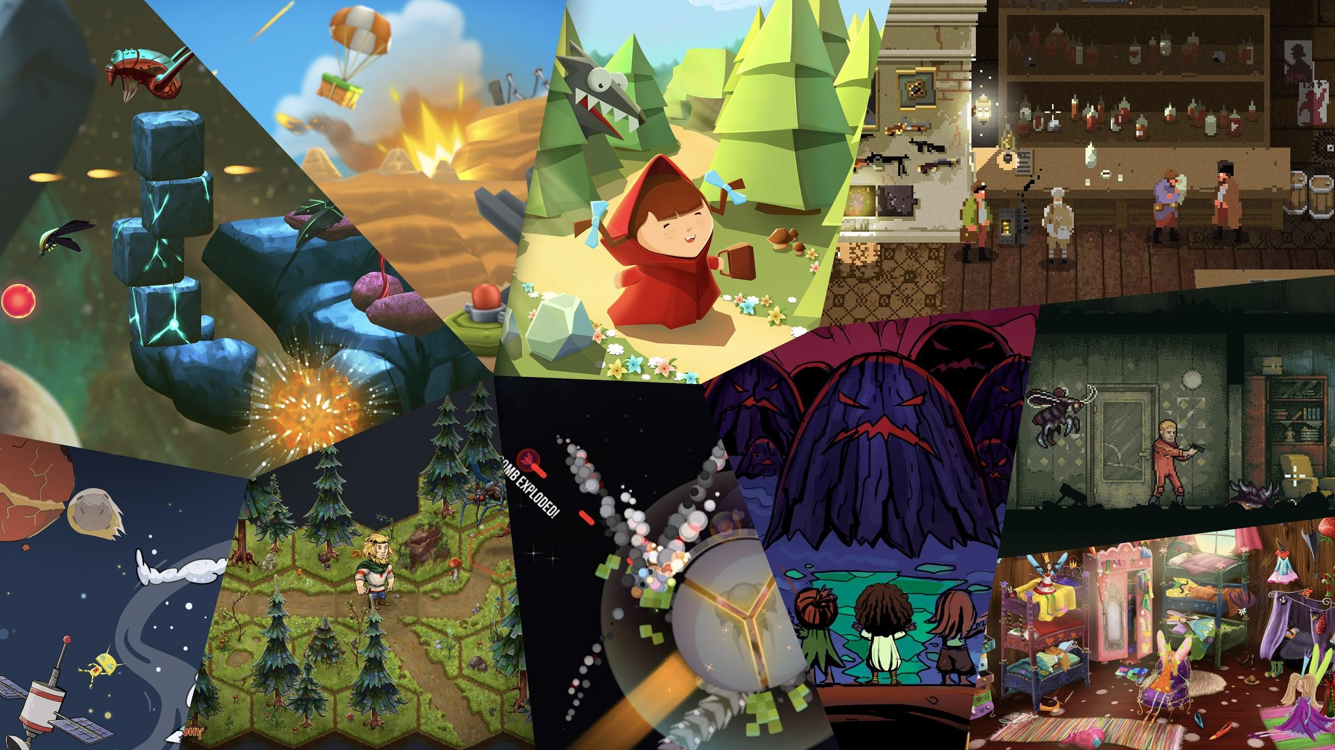

Slide 2
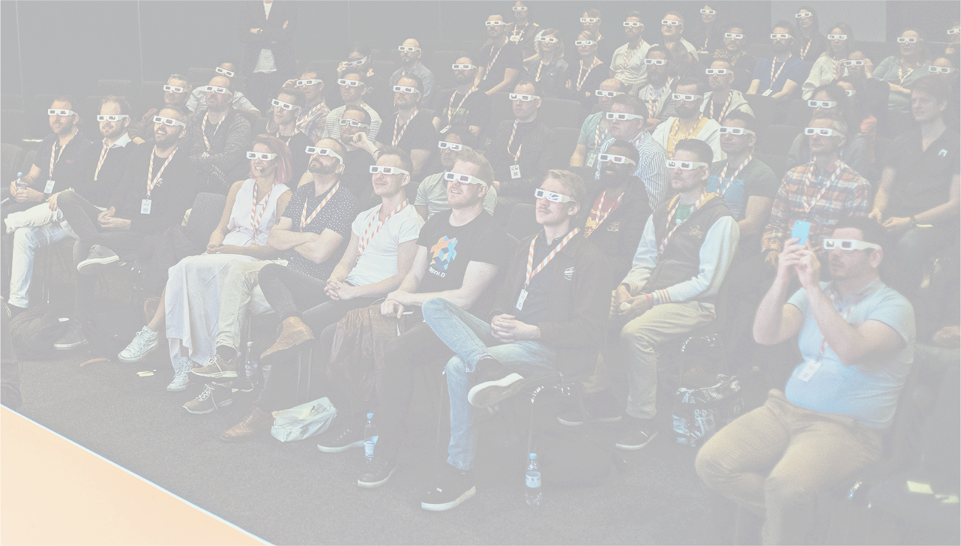
Björn Ritzl
Principal Engineer
Product Owner
bjorn.ritzl@king.com
Mathias Westerdahl
Principal Engineer
mathias.westerdahl@king.com

Slide 4
200
Notes:
200 games

Slide 6
268000000
Notes:
268M MAU
Q4 2018

Slide 7
2
Notes:
Our players swipe more than two laps around the globe on their mobiles every day!

Slide 9
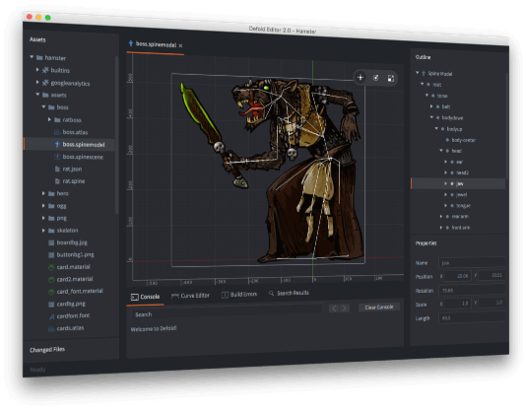
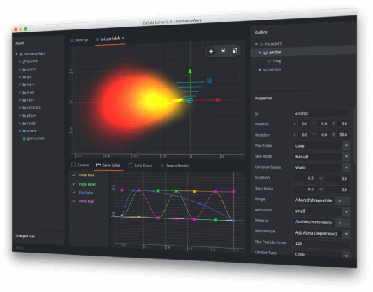

Slide 10
C/C++ engine
Lua for game logic
3D with 2D focus
Component based
Physics, 2D sprites, Spine models, tilemaps, 3D models, physics, sound, scripts, etc
Modular
Remove what you don't need
Extend with additional native code
Small
Google Play Instant
Facebook Instant Games
Playable ads

Slide 11
2016
Notes:
Free for anyone to use at GDC 2016

Slide 12
Notes:
More than 200 released games

Slide 13
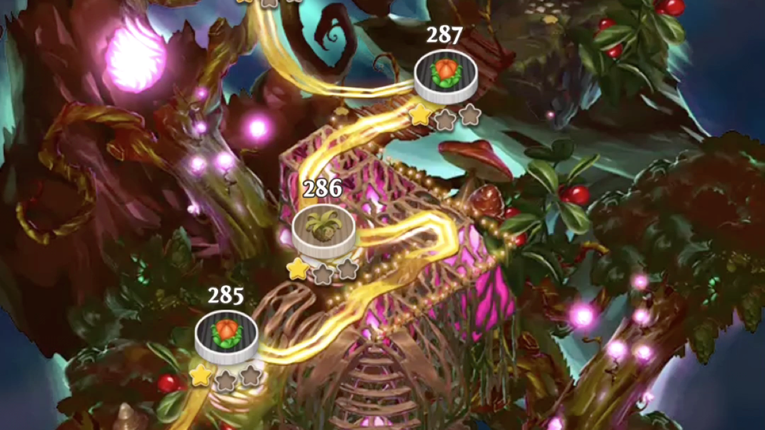
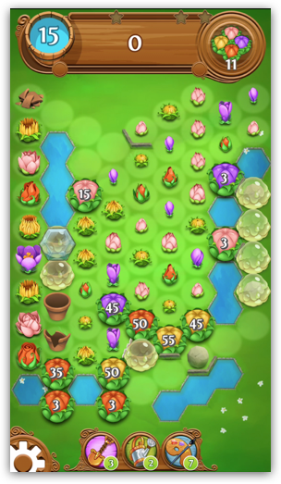

Slide 15
Notes:
Family Age

Slide 16
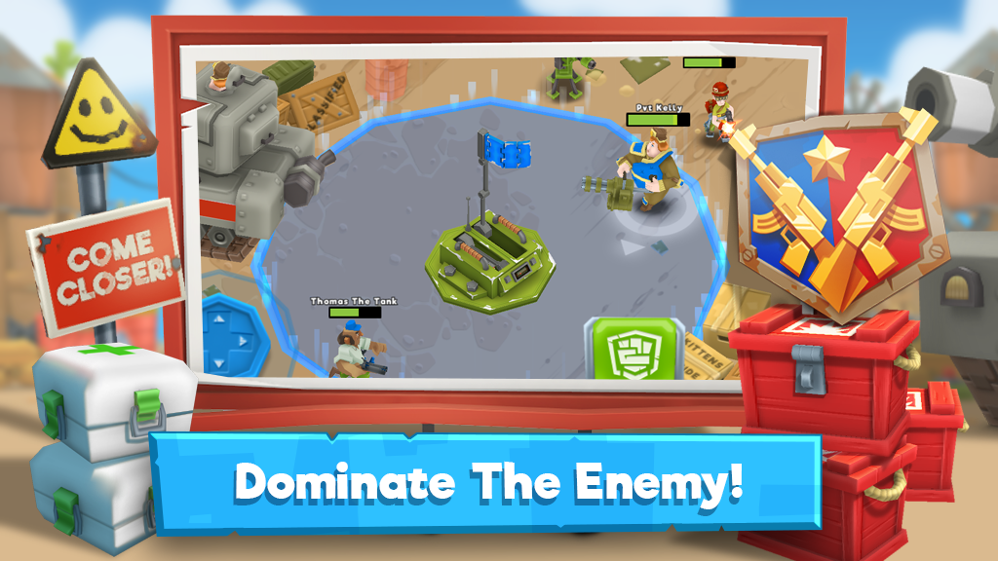
Notes:
Blastlands

Slide 17
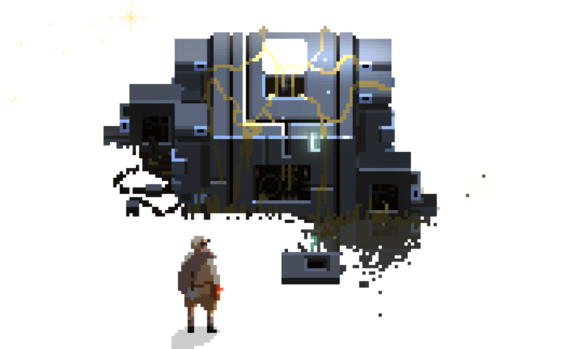
Debugging

Slide 18
Debugging in a cross platform game engine
Engine core in C/C++
Platform specific code on top
JS for HTML5
Objective-C for iOS and macOS
Java for Android
More C/C++
Ratio is somewhere around 20:1
Good debugging tools is a must
Usually enough to debug on host platform

Slide 19
Debugging HTML5 in a cross platform game engine
HTML5 builds using Emscripten
With support for WebAssembly
Emscripten can generate source maps
Browser dev tools support source maps
Debugging can be done in the browser
Even better if you can debug using a debugger of your choice
Remote debugging + IDE plugin
But what about WebAssembly?

Slide 20
Debugging graphics
Inspect textures, shaders, draw calls and frame composition
Open GL ES 2.0 and WebGL
Desktop and mobile has RenderDoc, XCode, GAPID
Very powerful tools
Debugging WebGL
Spector.js
Can the browser dev tools provide this?

